Slide 1

Computer Vision (CSE3010)
Dr. Susant Kumar Panigrahi
Assistant Professor
School of Electrical & Electronics Engineering

Slide 2
Module-1 Syllabus
Digital Image Formation And Low Level Processing:
Overview and State-of-the-art, Fundamentals of Image Formation, Transformation: Orthogonal, Euclidean, Affine, Projective, Fourier Transform,
Convolution and Filtering, Image Enhancement, Restoration, Histogram Processing.

Slide 3
Module-2 Syllabus
Depth Estimation And Multi-Camera Views:
Depth Estimation and Multi-Camera Views: Perspective, Binocular Stereopsis: Camera and Epipolar Geometry; Homography, Rectification, DLT, RANSAC, 3-D reconstruction framework; Auto-calibration. apparel.

Slide 4
Module-3 Syllabus
Feature Extraction And Image Segmentation:
Feature Extraction: Edges - Canny, LOG, DOG; Line detectors (Hough Transform), Corners - Harris and Hessian Affine, Orientation Histogram, SIFT, SURF, HOG, GLOH, Scale-Space Analysis- Image Pyramids and Gaussian derivative filters, Gabor Filters and DWT.
Image Segmentation: Region Growing, Edge Based approaches to segmentation, Graph-Cut, Mean-Shift, MRFs, Texture Segmentation; Object detection.

Slide 5
Module-4 Syllabus
Pattern Analysis And Motion Analysis:
Pattern Analysis: Clustering: K-Means, K-Medoids, Mixture of Gaussians, Classification: Discriminant Function, Supervised, Un-supervised, Semi-supervised; Classifiers: Bayes, KNN, ANN models;
Dimensionality Reduction: PCA, LDA, ICA; Non-parametric methods. Motion Analysis: Background Subtraction and Modelling, Optical Flow, KLT, Spatio-Temporal Analysis, Dynamic Stereo; Motion parameter estimation.

Slide 6
Module-5 Syllabus
Shape From X:
Light at Surfaces; Phong Model; Reflectance Map;
Albedo estimation; Photometric Stereo; Use of Surface Smoothness
Constraint; Shape from Texture, color, motion and edges.
Guest Lecture on Contemporary Topics

Slide 7
Text Books
Richard Szeliski, Computer Vision: Algorithms and Applications, Springer-Verlag London Limited 2011.
Computer Vision: A Modern Approach, D. A. Forsyth, J. Ponce, Pearson Education, 2003.
Reference Book(s):
R.C. Gonzalez and R.E. Woods, Digital Image Processing, Addison- Wesley, 1992.
Richard Hartley and Andrew Zisserman, Multiple View Geometry in Computer Vision, Second Edition, Cambridge University Press, March 2004.
K. Fukunaga; Introduction to Statistical Pattern Recognition, Second Edition, Academic Press, Morgan Kaufmann, 1990.
Required Tools/Software/IDLE:
Python/jupyter-notebook/google-colab
OpenCV
MATLAB

Slide 8
Indicative List of Experiments:
Implement image preprocessing and Edge
Implement camera calibration methods
Implement Projection
Determine depth map from Stereo pair
Construct 3D model from Stereo pair
Implement Segmentation methods
Construct 3D model from defocus image
Construct 3D model from Images
Implement optical flow method
Implement object detection and tracking from video
Face detection and Recognition
Object detection from dynamic Background for Surveillance
Content based video retrieval
Construct 3D model from single image

Slide 9
Computer Vision Unit – 01 Low-Level Vision (Image Transforms)

Slide 10
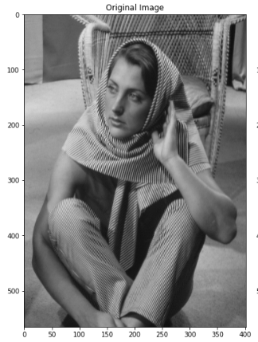
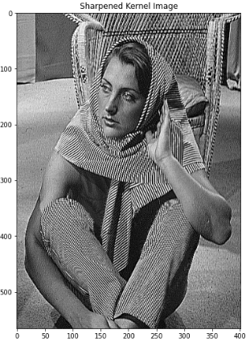
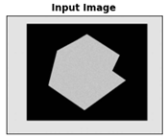
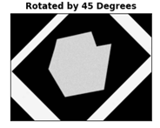



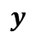
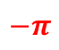


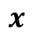
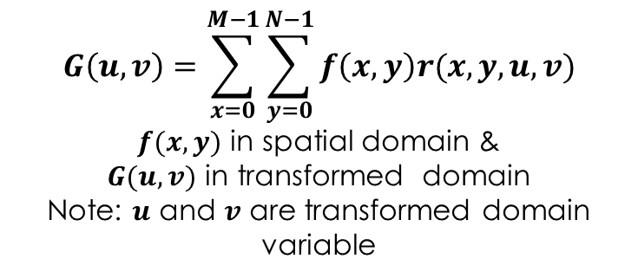

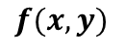
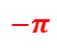
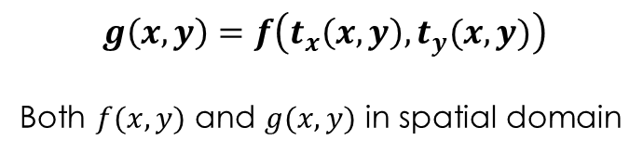
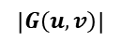
Image Transformation
An image transformation operation typically defines a new image 𝑔 in terms of an existing image 𝑓.
Domain /Orthogonal Transformation
Intensity Transformation
Geometric Transformation
𝒈(𝒙,𝒚)=𝒕(𝒇(𝒙,𝒚))
Both $f(x,y)$ and $g(x,y)$ in spatial domain
$$G\left(u,v\right)=\sum_{x=0}^{M−1}{\sum_{y=0}^{N−1}{f\left(x,y\right)r(x,y,u,v)}}$$
$f(x,y)$ in spatial domain &
$G(u,v)$ in transformed domain
Note: $u$ and $v$ are transformed domain variable
$$g\left(x,y\right)=f\left(t_{x}\left(x,y\right), t_{y}(x,y)\right)$$
Both $f(x,y)$ and $g(x,y)$ in spatial domain
Filtering on Intensity Values
$$f(x,y)$$
$$\left|G\left(u,v\right)\right|$$
$$−π$$
Rotation on spatial coordinate Values
Fourier Transform change in domain representation
$$u$$
$$x$$
$$(0,0)$$
$$π$$
$$−π$$
$$v$$
$$π$$
$$y$$

Slide 11
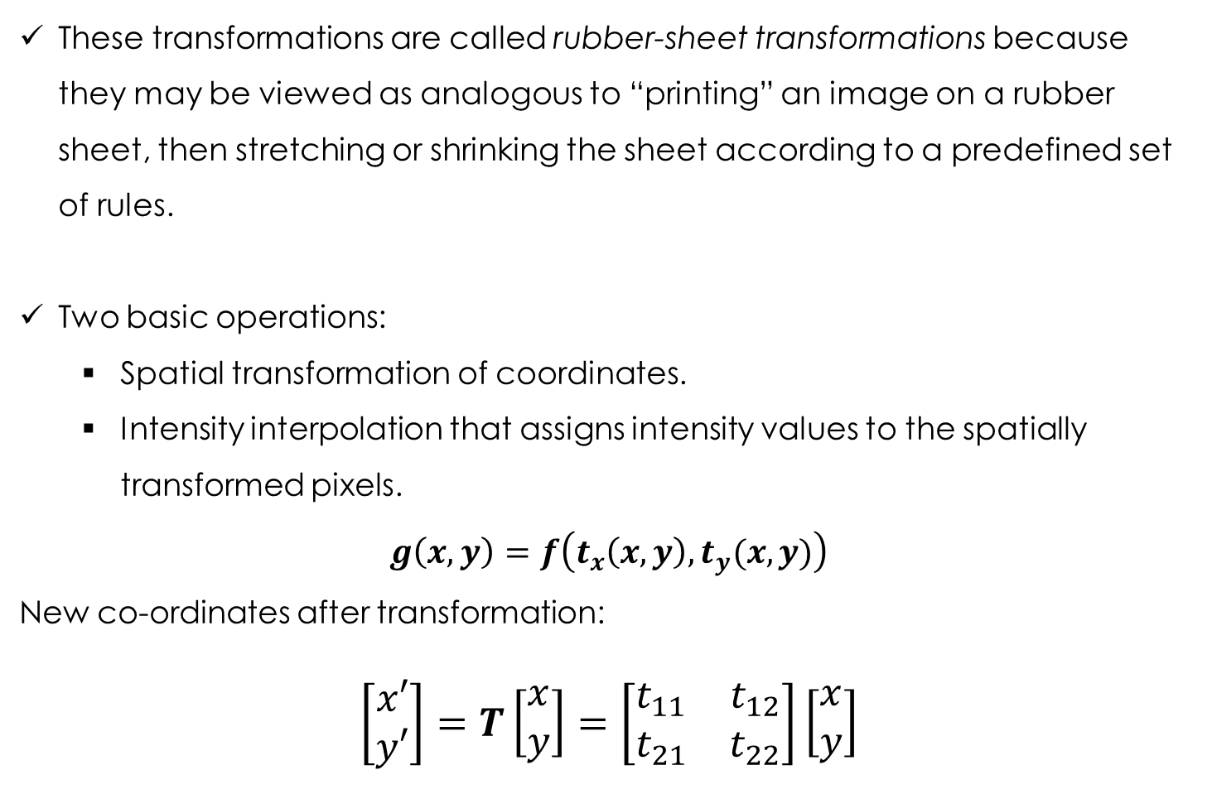
Geometric Transformation
These transformations are called rubber-sheet transformations because they may be viewed as analogous to “printing” an image on a rubber sheet, then stretching or shrinking the sheet according to a predefined set of rules.
Two basic operations:
Spatial transformation of coordinates.
Intensity interpolation that assigns intensity values to the spatially transformed pixels.
$$g\left(x,y\right)=f\left(t_{x}\left(x,y\right), t_{y}(x,y)\right)$$
New co-ordinates after transformation:
$$\left[\begin{matrix}x′ \\ y′\end{matrix}\right]=Τ\left[\begin{matrix}x \\ y\end{matrix}\right]=\left[\begin{matrix}t_{11} & t_{12} \\ t_{21} & t_{22}\end{matrix}\right]\left[\begin{matrix}x \\ y\end{matrix}\right]$$
Affine transformations are generalizations of Euclidean transformations.
For a matrix many of image properties are preserved and falls in the class of Euclidean transform.
On the other hand, for matrix few properties are changed after transformation falls under the general class of affine transform.
Notes:
Computer vision is an interdisciplinary scientific field that deals with how computers can gain high-level understanding from digital images or videos. From the perspective of engineering, it seeks to understand and automate tasks that the human visual system can do

Slide 12
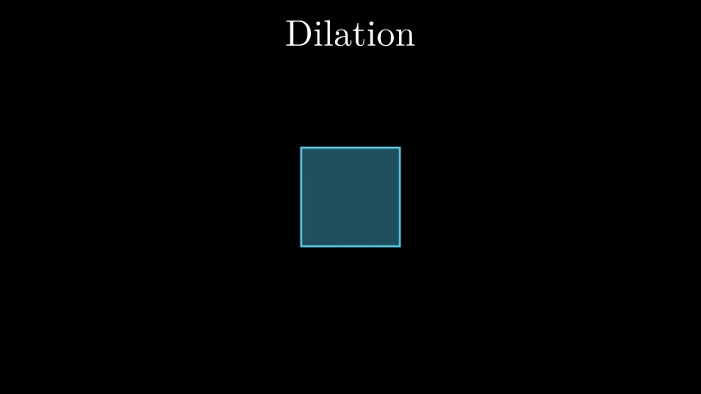
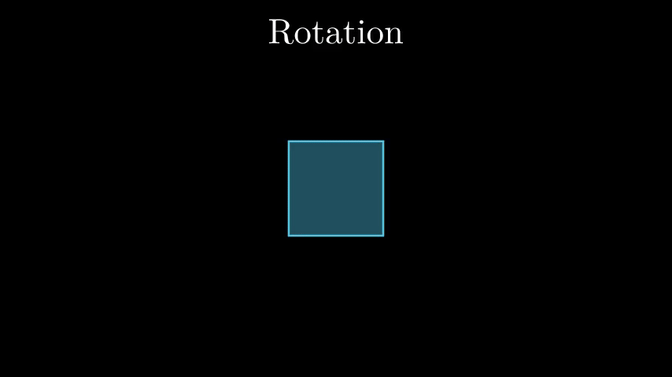
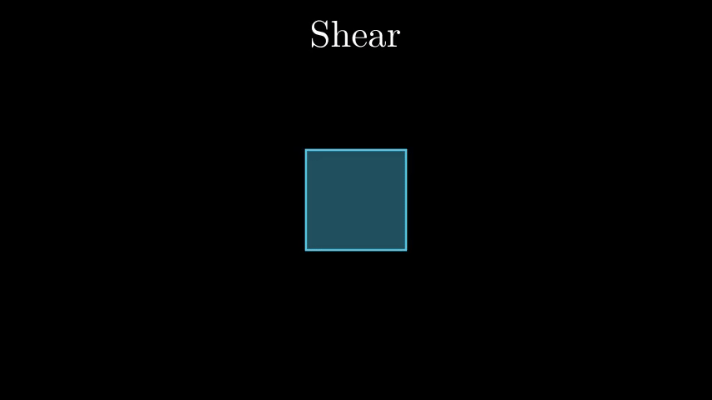
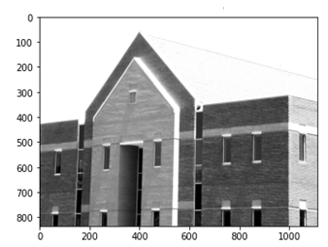
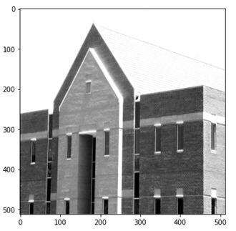
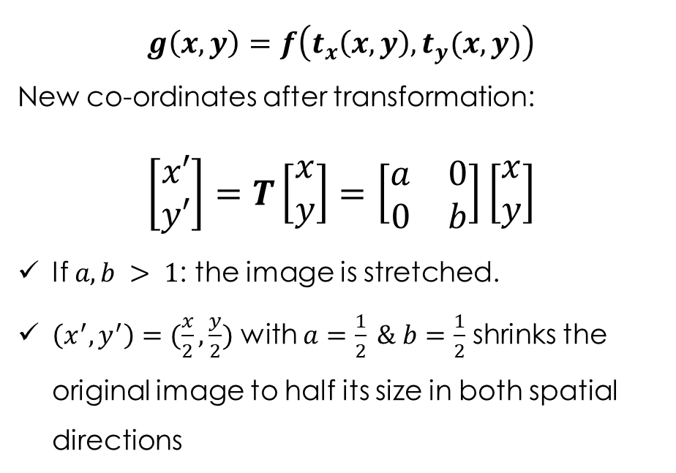
Geometric Transformation
Scaling/Dilation
$$g\left(x,y\right)=f\left(t_{x}\left(x,y\right), t_{y}(x,y)\right)$$
New co-ordinates after transformation:
$$\left[\begin{matrix}x′ \\ y′\end{matrix}\right]=Τ\left[\begin{matrix}x \\ y\end{matrix}\right]=\left[\begin{matrix}a & 0 \\ 0 & b\end{matrix}\right]\left[\begin{matrix}x \\ y\end{matrix}\right]$$
If $a, b > 1$: the image is stretched.
$\left(x^{′}, y^{′}\right)=(\frac{x}{2},\frac{y}{2})$ with $a=\frac{1}{2} \& b=\frac{1}{2}$ shrinks the original image to half its size in both spatial directions
𝜯
Pic Courtesy: 3Blue1Brown:https://www.youtube.com/watch?v=kYB8IZa5AuE

Slide 13
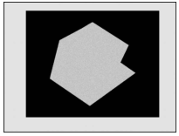
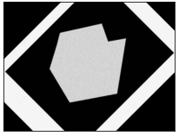


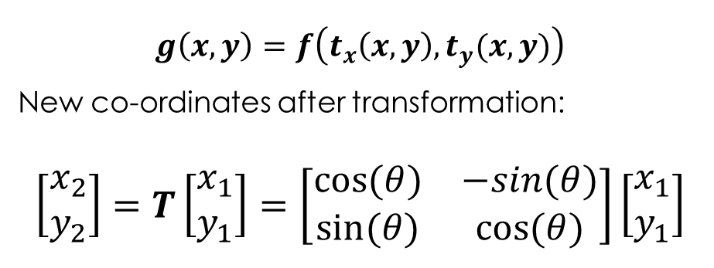
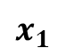
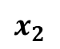
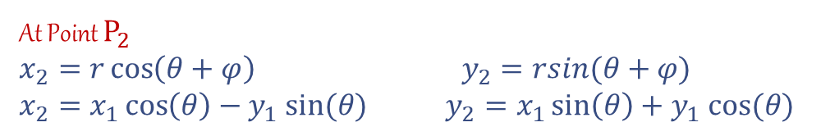
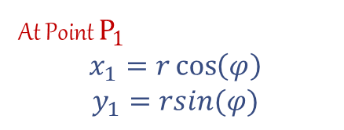

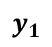
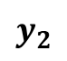
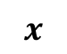
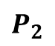
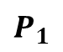
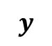
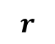
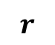
$$y$$
Rotation
$$y_{2}$$
$$P_{2}$$
$$g\left(x,y\right)=f\left(t_{x}\left(x,y\right), t_{y}(x,y)\right)$$
New co-ordinates after transformation:
$$\left[\begin{matrix}x_{2} \\ y_{2}\end{matrix}\right]=Τ\left[\begin{matrix}x_{1} \\ y_{1}\end{matrix}\right]=\left[\begin{matrix}cos⁡(θ) & −sin(θ) \\ sin⁡(θ) & cos⁡(θ)\end{matrix}\right]\left[\begin{matrix}x_{1} \\ y_{1}\end{matrix}\right]$$
$$P_{1}$$
$$y_{1}$$
$$r$$
At Point $P_{1}$
$$x_{1}=r\cos\left(φ\right)$$
$$y_{1}=rsin(φ)$$
$$r$$
$$θ$$
$$φ$$
$$x_{1}$$
$$x$$
$$x_{2}$$
At Point $P_{2}$
$x_{2}=r\cos\left(θ+φ\right)$ $y_{2}=rsin(θ+φ)$
$x_{2}=x_{1}\cos\left(θ\right)−y_{1} sin⁡(θ)$ $y_{2}=x_{1}\sin\left(θ\right)+y_{1} cos⁡(θ)$
𝜯
Image Rotated by ${45}^{0}$

Slide 14
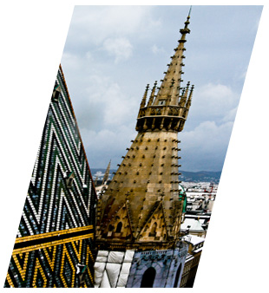
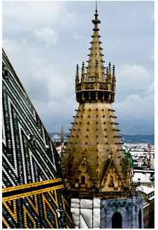
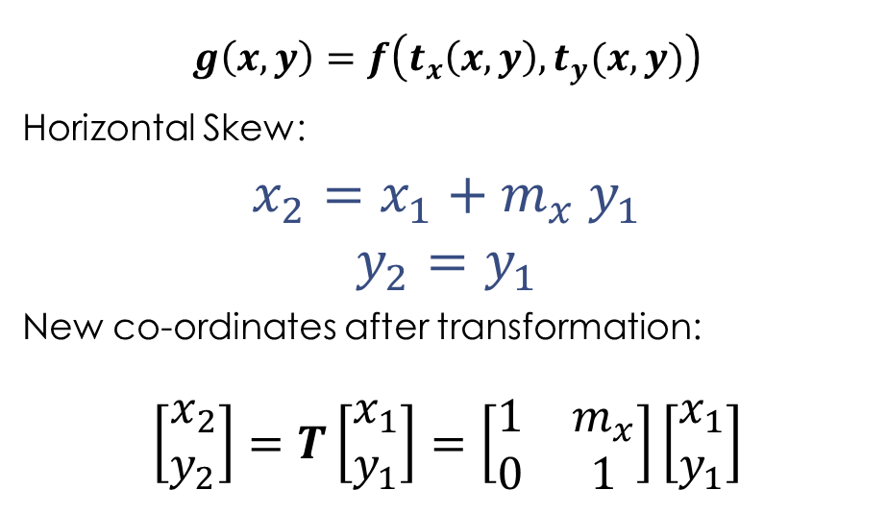
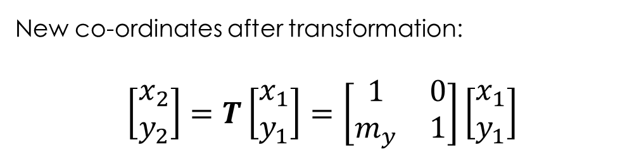
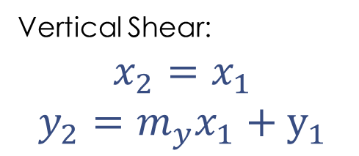
Skew or Shear (Horizontal and Vertical)
$$g\left(x,y\right)=f\left(t_{x}\left(x,y\right), t_{y}(x,y)\right)$$
Horizontal Skew:
$x_{2}=x_{1}+m_{x} y_{1}$
$$y_{2}=y_{1}$$
New co-ordinates after transformation:
$$\left[\begin{matrix}x_{2} \\ y_{2}\end{matrix}\right]=Τ\left[\begin{matrix}x_{1} \\ y_{1}\end{matrix}\right]=\left[\begin{matrix}1 & m_{x} \\ 0 & 1\end{matrix}\right]\left[\begin{matrix}x_{1} \\ y_{1}\end{matrix}\right]$$
Vertical Shear:
$$x_{2}=x_{1}$$
$y_{2}={m_{y}x}_{1}+y_{1}$
New co-ordinates after transformation:
$$\left[\begin{matrix}x_{2} \\ y_{2}\end{matrix}\right]=Τ\left[\begin{matrix}x_{1} \\ y_{1}\end{matrix}\right]=\left[\begin{matrix}1 & 0 \\ m_{y} & 1\end{matrix}\right]\left[\begin{matrix}x_{1} \\ y_{1}\end{matrix}\right]$$
𝜯

Slide 15
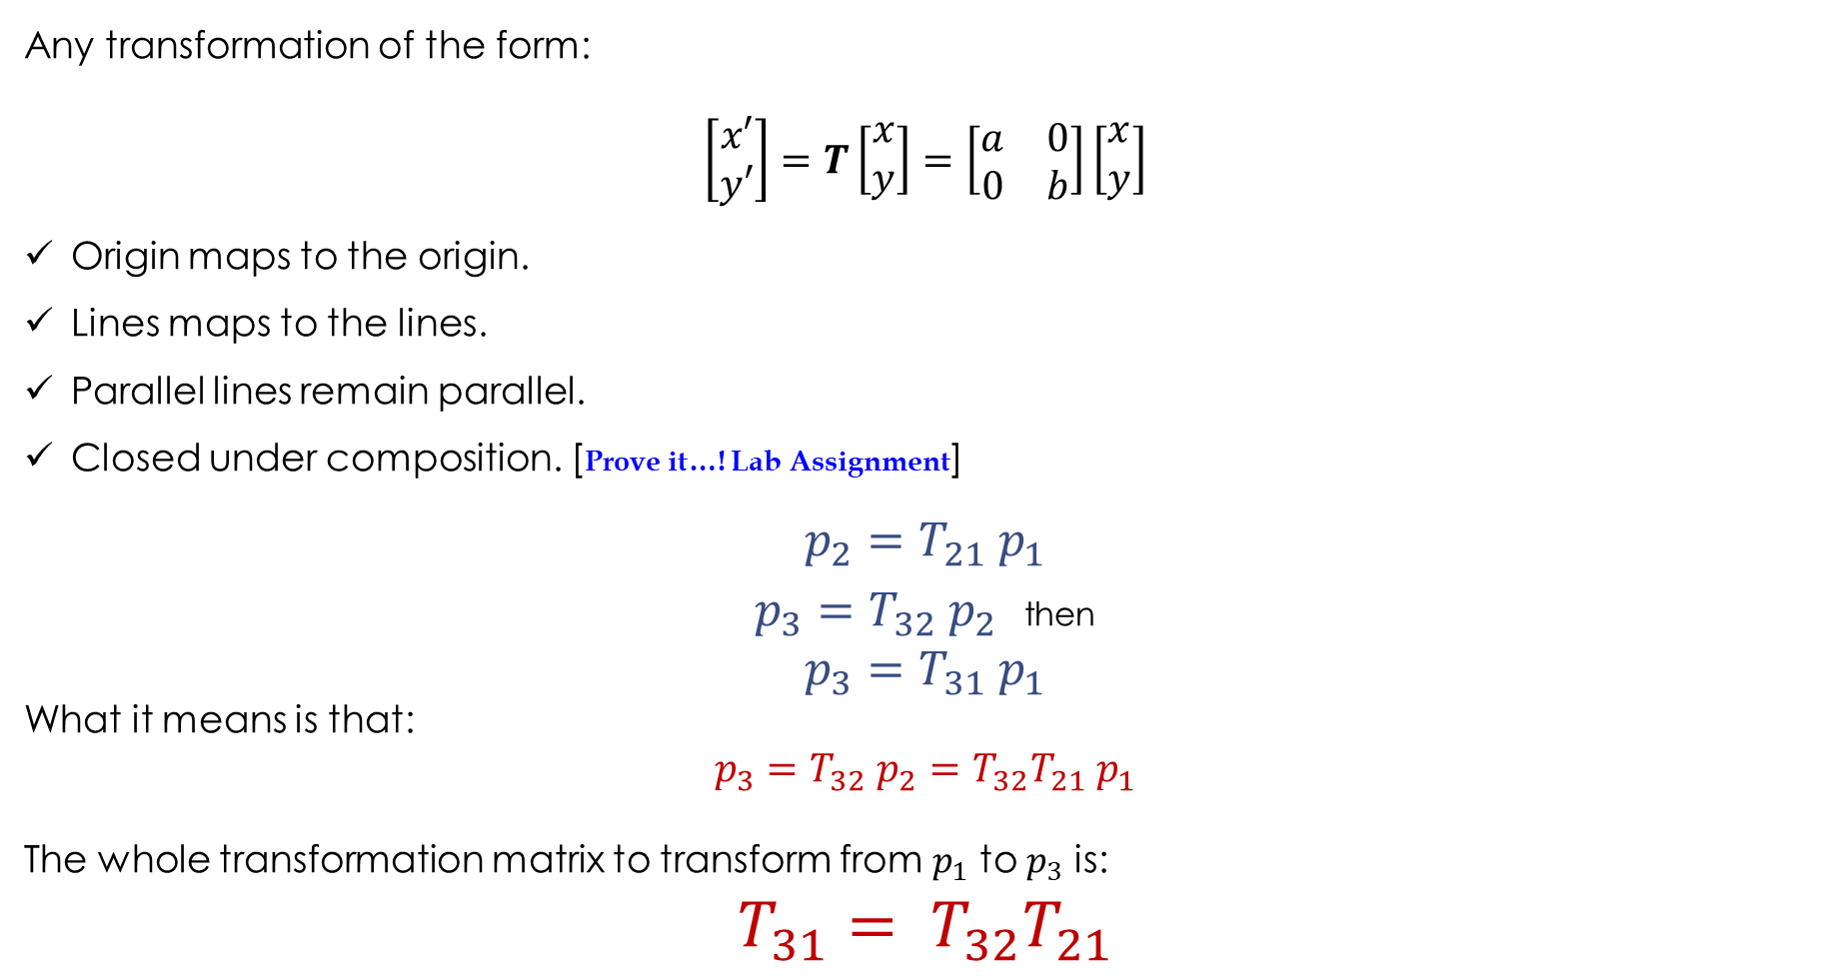
Properties of Euclidean Transformation
Any transformation of the form:
$$\left[\begin{matrix}x′ \\ y′\end{matrix}\right]=Τ\left[\begin{matrix}x \\ y\end{matrix}\right]=\left[\begin{matrix}a & 0 \\ 0 & b\end{matrix}\right]\left[\begin{matrix}x \\ y\end{matrix}\right]$$
Origin maps to the origin.
Lines maps to the lines.
Parallel lines remain parallel.
Closed under composition. [Prove it…! Lab Assignment]
$$p_{2}=T_{21} p_{1}$$
$p_{3}=T_{32} p_{2}$ then
$$p_{3}=T_{31} p_{1}$$
What it means is that:
$$p_{3}=T_{32} p_{2}=T_{32}T_{21} p_{1}$$
The whole transformation matrix to transform from $p_{1}$ to $p_{3}$ is:
$${T_{31}= T}_{32}T_{21}$$
Notes:
Computer vision is an interdisciplinary scientific field that deals with how computers can gain high-level understanding from digital images or videos. From the perspective of engineering, it seeks to understand and automate tasks that the human visual system can do

Slide 16

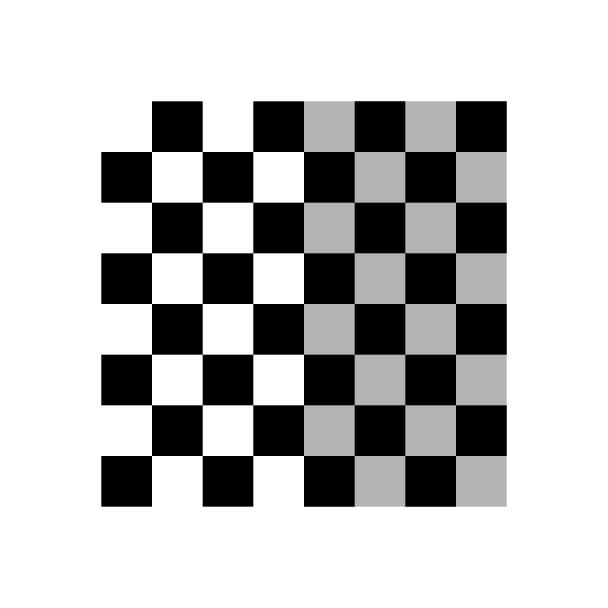
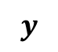
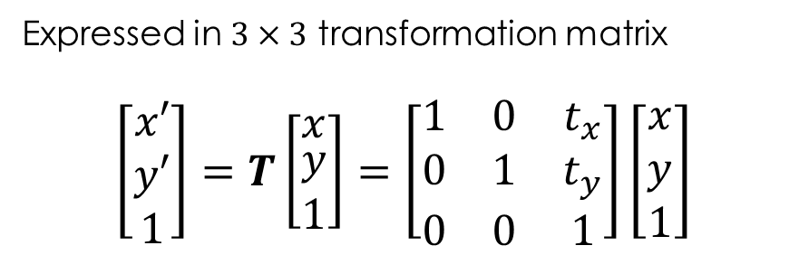
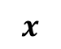


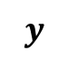

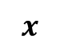
Affine Transform (a $3×3$ matrix for geometric transformation)
Translation
$$g\left(x,y\right)=f\left(t_{x}\left(x,y\right), t_{y}(x,y)\right)$$
New co-ordinates after transformation:
$$x^{′}=x+t_{x} y^{′}=y+t_{y}$$
$$y$$
$$y$$
Can translation be expressed in 2D matrix?
NO!
$$t_{y}$$
Expressed in $3×3$ transformation matrix
$$\left[\begin{matrix}x′ \\ y′ \\ 1\end{matrix}\right]=Τ\left[\begin{matrix}x \\ \begin{aligned}y \\ 1\end{aligned}\end{matrix}\right]=\left[\begin{matrix}1 & 0 & t_{x} \\ 0 & 1 & t_{y} \\ 0 & 0 & 1\end{matrix}\right]\left[\begin{matrix}x \\ y \\ 1\end{matrix}\right]$$
$$x$$
$$t_{x}$$
$$x$$

Slide 17
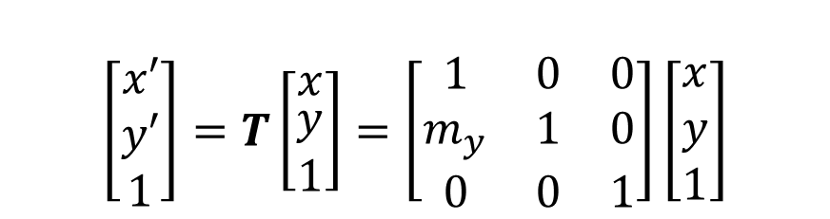
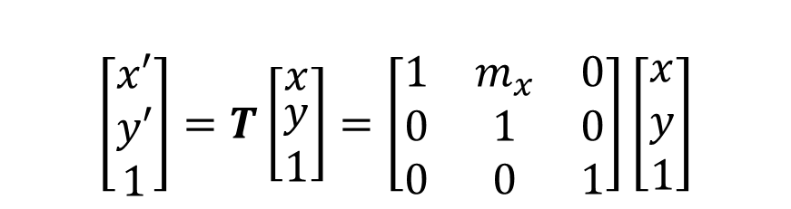
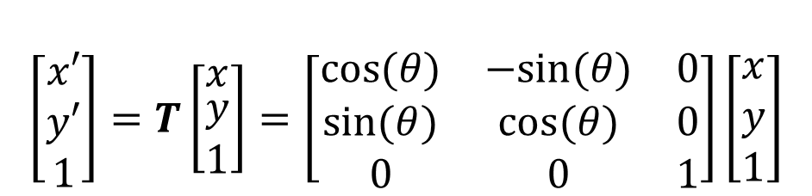
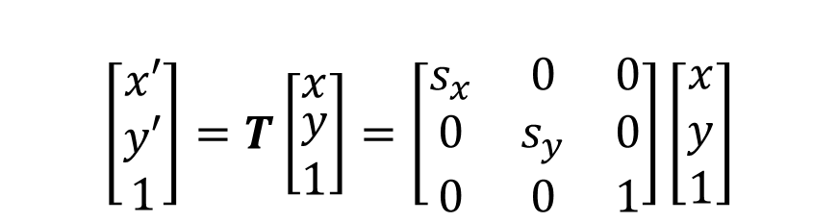
Affine Transform (a $3×3$ matrix for geometric transformation)
Scaling
Rotation
$$\left[\begin{matrix}x′ \\ y′ \\ 1\end{matrix}\right]=Τ\left[\begin{matrix}x \\ \begin{aligned}y \\ 1\end{aligned}\end{matrix}\right]=\left[\begin{matrix}s_{x} & 0 & 0 \\ 0 & s_{y} & 0 \\ 0 & 0 & 1\end{matrix}\right]\left[\begin{matrix}x \\ y \\ 1\end{matrix}\right]$$
$$\left[\begin{matrix}x′ \\ y′ \\ 1\end{matrix}\right]=Τ\left[\begin{matrix}x \\ \begin{aligned}y \\ 1\end{aligned}\end{matrix}\right]=\left[\begin{matrix}cos⁡(θ) & −sin⁡(θ) & 0 \\ sin⁡(θ) & cos⁡(θ) & 0 \\ 0 & 0 & 1\end{matrix}\right]\left[\begin{matrix}x \\ y \\ 1\end{matrix}\right]$$
Shear (Horizontal)
Shear (Vertical)
$$\left[\begin{matrix}x′ \\ y′ \\ 1\end{matrix}\right]=Τ\left[\begin{matrix}x \\ \begin{aligned}y \\ 1\end{aligned}\end{matrix}\right]=\left[\begin{matrix}1 & m_{x} & 0 \\ 0 & 1 & 0 \\ 0 & 0 & 1\end{matrix}\right]\left[\begin{matrix}x \\ y \\ 1\end{matrix}\right]$$
$$\left[\begin{matrix}x′ \\ y′ \\ 1\end{matrix}\right]=Τ\left[\begin{matrix}x \\ \begin{aligned}y \\ 1\end{aligned}\end{matrix}\right]=\left[\begin{matrix}1 & 0 & 0 \\ m_{y} & 1 & 0 \\ 0 & 0 & 1\end{matrix}\right]\left[\begin{matrix}x \\ y \\ 1\end{matrix}\right]$$
Closed under composition…?

Slide 18

Properties of Affine Transformation
Any transformation of the form:
$$\left[\begin{matrix}x′ \\ y′ \\ 1\end{matrix}\right]=Τ\left[\begin{matrix}x \\ \begin{aligned}y \\ 1\end{aligned}\end{matrix}\right]=\left[\begin{matrix}a_{11} & a_{12} & a_{13} \\ a_{21} & a_{22} & a_{23} \\ 0 & 0 & 1\end{matrix}\right]\left[\begin{matrix}x \\ y \\ 1\end{matrix}\right]$$
Origin does not necessarily maps to the origin.
Lines maps to the lines.
Parallel lines remain parallel.
Closed under composition. [Prove it…! Lab Assignment]

Slide 22

Orthogonal/Domain Transformation
[Fourier Transform]
Inverse Transform
Forward Transform

Slide 23




Signal Transformation: Formulation
Any signal $f∈ ℛ^{M×1}$ can be represented as:
$$α=\left\langle f, φ_{i}\right\rangle$$
-----(1)
Inner Product for Functional Space.
Dot product for vector space.
Transformed Coefficient
$$α∈ ℂ^{T×M}$$
Basis Function or Dictionary
Dictionary & Its Property
Dictionary/Basis Function
$Φ={[φ_{1 },φ_{2 },……,φ_{T}]}_{M×T}$
Such that:
$$∀i ∈ \left\{1, 2, …, T\right\}, {\left\|φ_{i}\right\|}^{2}= \sum_{n=1}^{N}{{\left|φ_{i}[m]\right|}^{2}}$$
Orthogonal:
$Φ^{∗}=Φ^{−1}$
-----(2)
Atoms: $φ_{i} ∈ℂ^{1×M}$

Slide 24

Fourier Space
Functional Space.
Basis function/Dictionary: [Infinitely Oscillating Sinusoids]
$$Φ_{DFT}= {\left\{e^{−i2πkn/N}\right\}}_{0≤k≤N−1}= {\left[\begin{matrix}1 & ⋯ & 1 \\ ⋮ & ⋱ & ⋮ \\ 1 & ⋯ & e^{−\frac{j2π\left(N−1\right)\left(N−1\right)}{N}}\end{matrix}\right]}_{N×N}$$
Forward Transform (DFT):
$$F\left(k\right)=\sum_{n=0}^{N−1}{f\left(n\right)e^{−j2πkn/N}}$$
for $0≤k≤N−1$
Inverse DFT:
$$f(n)=\left\langle Φ_{DFT}, F(k)\right\rangle$$
$$f\left(n\right)=\frac{1}{N}\sum_{k=0}^{N−1}{F\left(k\right)e^{j2πkn/N}}$$
Orthonormal Column Space
-----(3)
-----(4)

Slide 25

Fourier Transform for Image
Image is an 2D spatial variable.
Assuming an image $f(x, y)$of dimension $M×N$, the discrete Fourier transform can be represented as:
Forward Transform (DFT):
$$F\left(u, v\right)=\sum_{x=0}^{N−1}{\sum_{y=0}^{M−1}{f\left(x,y\right)e^{−j2π(\frac{ux}{N}+\frac{vy}{M})}}}$$
for $0≤u≤N−1$
$$0≤v≤M−1$$
Inverse DFT:
$$f\left(x, y\right)=\frac{1}{MN}\sum_{u=0}^{N−1}{\sum_{v=0}^{M−1}{F\left(u,v\right)e^{j2π(\frac{ux}{N}+\frac{vy}{N})}}}$$

Slide 26

Fourier Transform in Python
Notes:
https://www.v7labs.com/blog/computer-vision-applications

Slide 27
Magnitude and Phase Spectrum of Image (Example)
(a)
(b)
(c)
Fig. (a) Original image (512 × 512 pixels); (b) Fourier magnitude spectrum of the image in (a); (c) Fourier phase spectrum of the image in (a); Note: The magnitude spectrum is displayed in $log⁡scale$for better representation.

Slide 28


















Magnitude Spectrum of Image (Centred Spectrum)
# fftshift to keep the 0th freq. component at center.
img_fft_magshift = np.fft.fftshift(img_fft_mag)
img_fft_magshift = np.log(img_fft_magshift + np.finfo(float).eps)
# For better display. Change Magnitude to log-Scale.
img_fft_mag1 = np.log(img_fft_mag + np.finfo(float).eps)
$$\left|F\left(u,v\right)\right|$$
$$\left|F\left(u,v\right)\right|$$
$$0$$
$$−π$$
$$f(x,y)$$
$$x$$
$$u$$
$$u$$
$$(0,0)$$
$$y$$
$$2π$$
$$π$$
$$0$$
$$v$$
$$2π$$
$$−π$$
$$v$$
$$π$$

Slide 29

Importance of Phase in Image Reconstruction
During the spatial frequency representation of signal, spatial magnitude and phase tends to play different role. In general, important features are preserved in phase$.^{1}$
If the magnitude is eliminated from the transformed domain many of important characteristic of the signal nevertheless preserved. With so much intelligibility integrated in the phase, it is natural to consider that the possibility of recovering some or perhaps all of the magnitude information from the phase.
Phase retains information about the shape of the image (phase congruency and edges), while magnitude infers the strength of these local or global shape.
For almost all natural images the magnitude spectrum (for Fourier domain) remain identical (maximum peak at center (zeroth) frequency and gradually decreases as frequency increases), while the phase spectrum retains distinct information$.^{2}$
V. Oppenheim and J. S. Lim, “The importance of phase in signals,” Proceedings of the IEEE, vol. 69, no. 5, pp. 529–541, 1981.
Panigrahi, S.K. and Gupta, S., 2013, April. Quantitative evaluation of image information retention by relative phases. In 2013 Students Conference on Engineering and Systems (SCES) (pp. 1-6). IEEE..

Slide 30

Importance of Phase in Image Reconstruction
Fourier Transformed Phase Of Image2
Fourier Transformed Magnitude Of Image2
Fourier Transformed Magnitude Of Image1
Fourier Transformed Phase Of Image1

